Slide 1
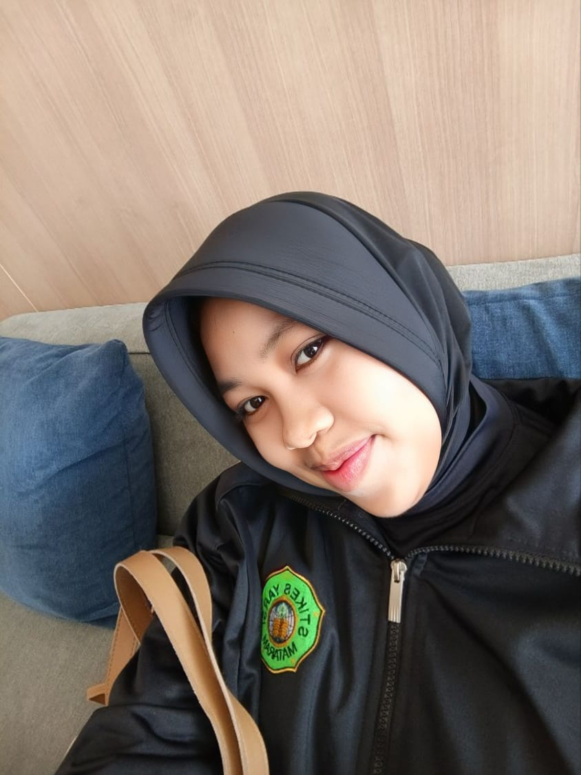
Poppy Putri Azensa
Azensaputri@gmail.com
JL. Sultan Kaharuddin No. 5 Kelungkung Gg. Cardivae
Detile Profile

