Slide 1
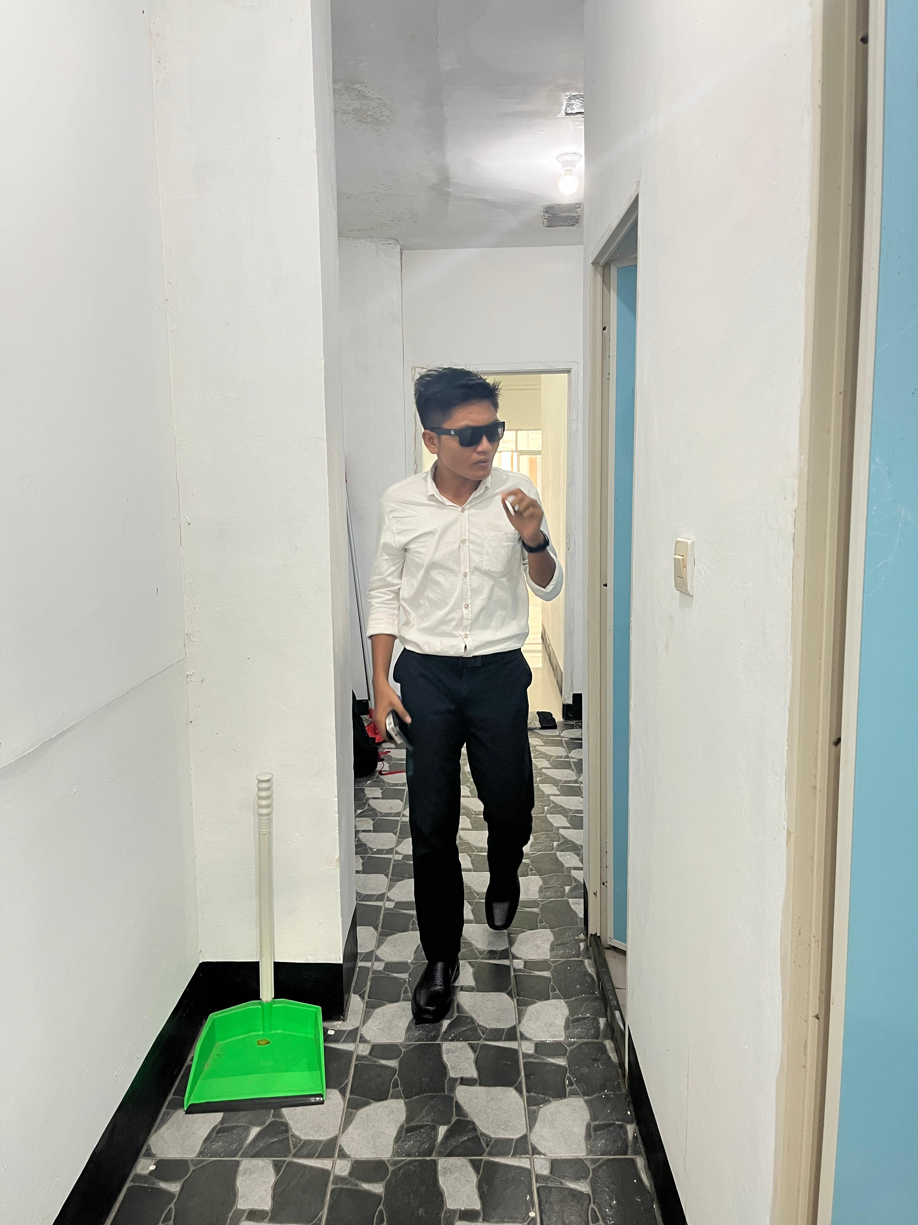
RAHMAN HAMDANI
rahmanhamdani93@gmail.com
TEMU KUNING
Detle Profile

